Slide 1
Naïve Bayes Classifier

Slide 2
Naïve Bayes Classifier
Supervised form of learning.
A probabilistic framework to solve classification problems.
Works on Conditional probability.
Based on Bayes theorem.
Notes:
Supervised learning algo based on Bayes theorem and used to solve classification problem.
Probabilistic classifier which means it predicts on the basis of the probability of an object.

Slide 3
Need of Naive Bayes Classifier
Relationship between features and the class variable is non- deterministic.
Need an approach to model probabilistic relationship between the features and class variable.

Slide 4
Application of Naive Bayes Classifier
Medical Diagnosis: predict whether a person is suffering from diabetes based on his diet and daily workout.
Spam Classification: predict whether an email is spam or not.
Weather: predict whether it will rain tomorrow based on temperature, humidity, wind speed, etc.

Slide 5
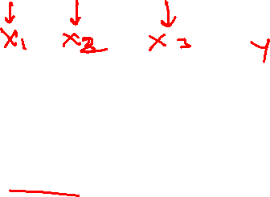
Naïve Bayes
Naïve because it assumes that the occurrence of a certain feature is independent of the occurrence of other features.

Slide 6

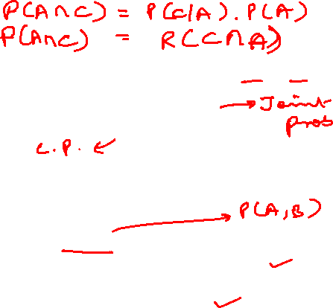
Conditional Probability
Let say there are two events, A and C
Conditional Probability:
$$P\left(C | A\right)=\frac{P(A∩C)}{P(A)}$$
P(C|A): Probability of event C occurring given that event A has already occurred.
P(A ⋂ C) is joint probability that both the events A and C has occurred.
P(A) probability of occurring of event A.

Slide 7


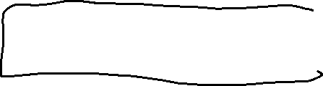

Slide 8


Bayes Theorem
Bayes Rule: $P\left(C | A\right)=\frac{P\left(A | C\right).P(C)}{P(A)}$
here,
P(C) and P(A): independent probability (prior probability).
P(A|C): conditional probability of A given C (likelihood).
P(C|A): conditional probability of C given A (posterior probability).

Slide 9

Example of Bayes Theorem
Given:
P(C): patient has liver disease, 10% of patients having liver disease.
P(A): patient is an alcoholic, 5% of patients are alcoholic.
P(A|C): probability that patient is alcoholic given that he has a liver disease, 7%.

Slide 10
Example of Bayes Theorem
Find out a patient’s probability of having liver disease if they are alcoholic.
According to Bayes theorem:
P(C|A)= (0.07*0.1)/0.05=0.14
Therefore, 14% chances of a patient having liver disease if they are alcoholic.

Slide 11


Naive Bayes Classifier
Consider each attribute and each class label as random variables.
Given a dataset D with attributes set A(A₁, A₂,…A_{n}) and class labels as C(C₁,…C_{m}). Let us given a record with attribute values:
Goal: predict class label C_{i}
Specifically, we want to find the value of C_{i} that maximizes P(C_{i}|A)

Slide 12


Naive Bayes Classifier
Compute posterior probability P(C_{i}|A₁, A₂,…..A_{n}) for all C_{i} using Bayes theorem:
$$P\left(C_{i} | A_{1},A_{2},…..,A_{n}\right)=\frac{P\left(A_{1},A_{2},…,A_{n}|C_{i}\right).P(C_{i})}{P\left(A_{1},A_{2},…,A_{n}\right)}$$
If P(C_{i}|A₁, A₂,…..A_{n})> P(C_{j}|A₁, A₂,…..A_{n}), then the class label is C_{i}
How to find $P\left(A_{1},A_{2},…,A_{n}|C_{i}\right)$?

Slide 13

Naive Bayes Classifier
Assume independence among attributes A_{i} when class labels are given.
$P\left(A_{1},A_{2},…,A_{n}|C_{i}\right)=P\left(A_{1} | C_{i}\right).P\left(A_{2} | C_{i}\right)……P(A_{n}|C_{i})$

Slide 14
Working of Naïve Bayes Classifier

Slide 15

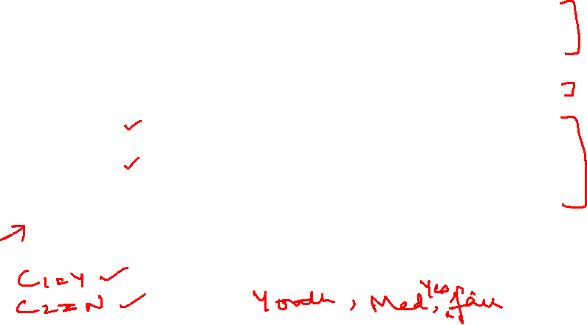
ID | Age | Income | Student | Credit_Rating | Buys_computer
1 | youth | high | no | fair | NO
2 | youth | high | no | excellent | NO
3 | middle | high | no | fair | YES
4 | senior | medium | no | fair | YES
5 | senior | low | yes | fair | YES
6 | senior | low | yes | excellent | NO
7 | middle | low | yes | excellent | YES
8 | youth | medium | no | fair | NO
9 | youth | low | yes | fair | YES
10 | senior | medium | yes | fair | YES
11 | youth | medium | yes | excellent | YES
12 | middle | medium | no | excellent | YES
13 | middle | high | yes | fair | YES
14 | senior | medium | no | excellent | NO

Slide 16

Naive Bayes Classifier Example
Given: tuple X <youth, medium, yes, fair, buys_computer=?>
Task: predict whether person X will buy computer?
Let us assume C₁ = YES and C₂ = NO
P(C₁) = 9/14 = 0.643 and P(C₂) = 5/14 = 0.357

Slide 17
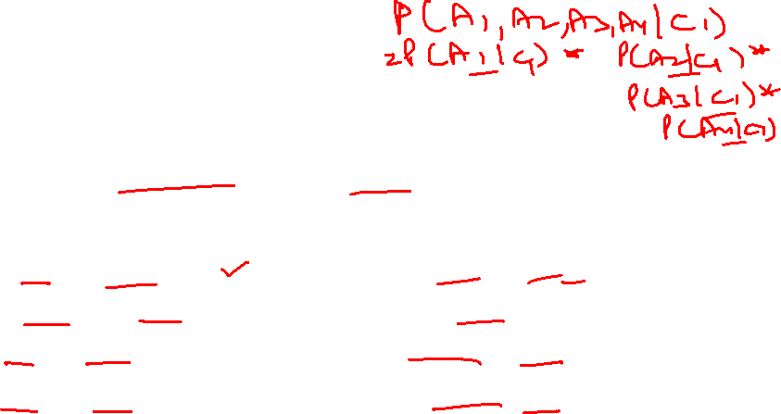
Naive Bayes Classifier Example
To Compute P(X|C₁) and P(X|C₂), first compute following conditional probabilities:
P(youth|C₁) = 2/9=0.222
P( medium|C₁) = 4/9= 0.444
P(yes|C₁) = 6/9 =0.667
P(fair|C₁) = 6/9 =0.667
P(youth|C₂) = 3/5=0.600
P(medium|C₂) = 2/5=0.400
P(yes|C₂) = 1/5=0.2000
P(fair|C₂) = 2/5=0.400

Slide 18
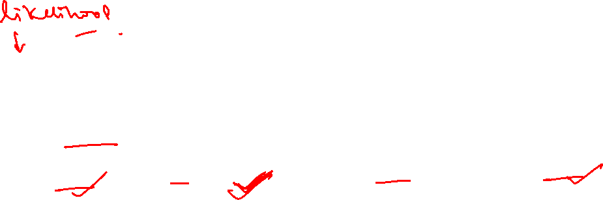
Naive Bayes Classifier Example
P(X|C₁)=P(youth|C₁)*P(medium|C₁)* P(yes|C₁)*P(fair|C₁) = 0.222*0.444*0.667* 0.667 = 0.044
P(X| C₁).P(C₁) =0.044 * 0.643=0.028
P(X|C₂) = P(youth|C₂)* P(medium|C₂)* P(yes|C₂)*P(fair|C₂) = 0.600*0.400*0.200* 0.400 = 0.019
P(X| C₂).P(C₂)= 0.019 * 0.357= 0.007

Slide 19
Naive Bayes Classifier Example
Final class C_{i} is that maximizes P(X| C_{i}).P(C_{i})
P(X| C₁).P(C₁) > P(X| C₂).P(C₂), so tuple X class label is C₁

Slide 20
Types of Naïve Bayes Classifier

Slide 21
Types of Naïve Bayes Classifier
Naïve Bayes Classifier
Gaussian
Multinomial
Bernoulli

Slide 22

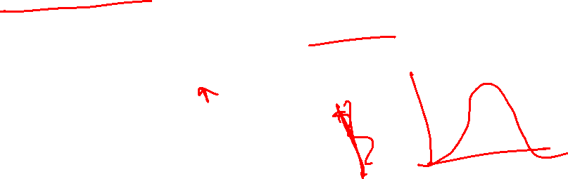
Gaussian Naïve Bayes Classifier
Used for continuous valued attributes, for example: age attribute.
Works on the assumption the data follows the Gaussian normal distribution.
Gaussian formula: $P\left({x_{i}}/{y }\right)= \frac{1}{\sqrt{2πσ_{y}^{2} }} e^{(−\frac{{{(x}_{i}−μ_{y})}^{2}}{{2σ}_{}^{2}y})}$

Slide 23
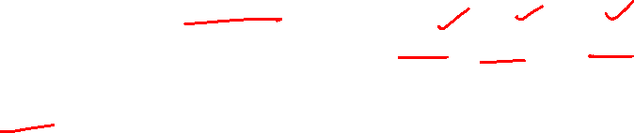
Multinomial Naïve Bayes Classifier
Mostly used for document classification problem.
For example: document belongs to the category of sports, politics, technology, etc.
The attributes used for classification are the frequency of the words present in the document.

Slide 24
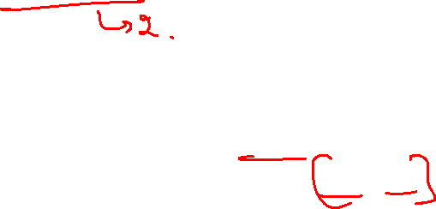
Bernoulli Naïve Bayes Classifier
Similar to multinomial naïve bayes classifier.
But the attributes are boolean valued only .
For example: if a word occurs in a text yes or no.

Slide 25
Thank You

